Slide 1
Transport Layer Overview

Slide 2
Purpose
To deliver data across networks with the desired reliability or quality

Slide 3
Transport vs Network
Network layer: Delivery from/to devices
Transport layer: Delivery from/to processes (s/w applications)
Analogy with the postal service
Postal Address |  | Layered Network Analogy
George Oikonomou | Person within building (Transport) | Process within a host
Office 5.09 Merchant Venturers Building BS8 1UB Bristol UK | Building address (Network Layer) | Host address (e.g. IP address)

Slide 4
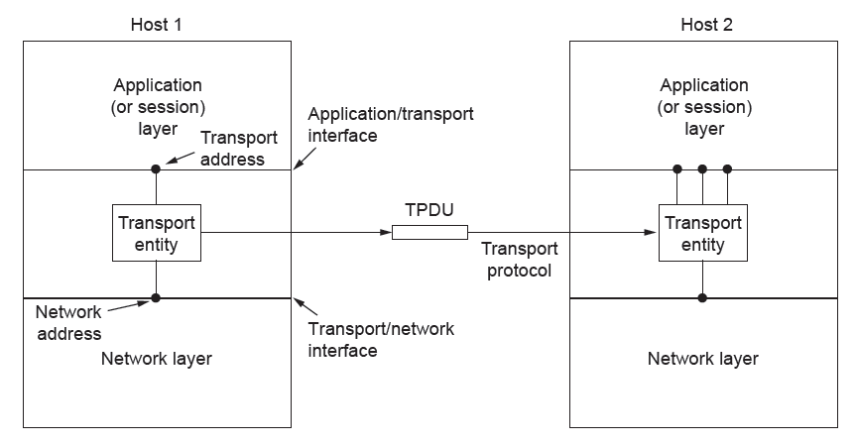
Services Provided to the Upper Layers
The network, transport, and application layers

Slide 5
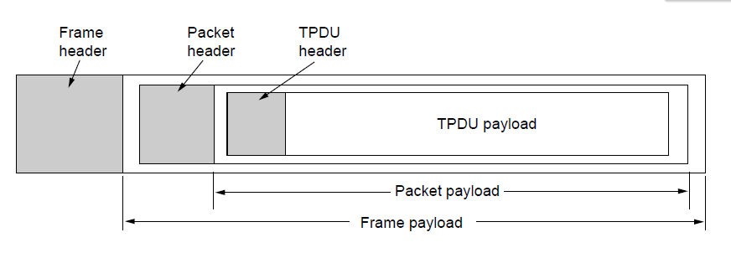
Transport Service Primitives
Nesting of TPDUs, packets, and frames.

Slide 6
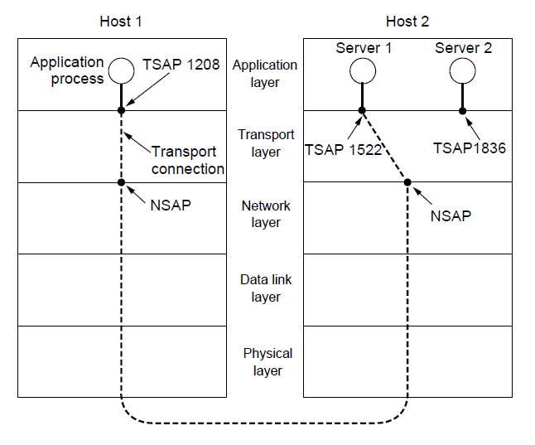
TSAPs and NSAPs
Transport / Network Service Access Point

